Slide 1
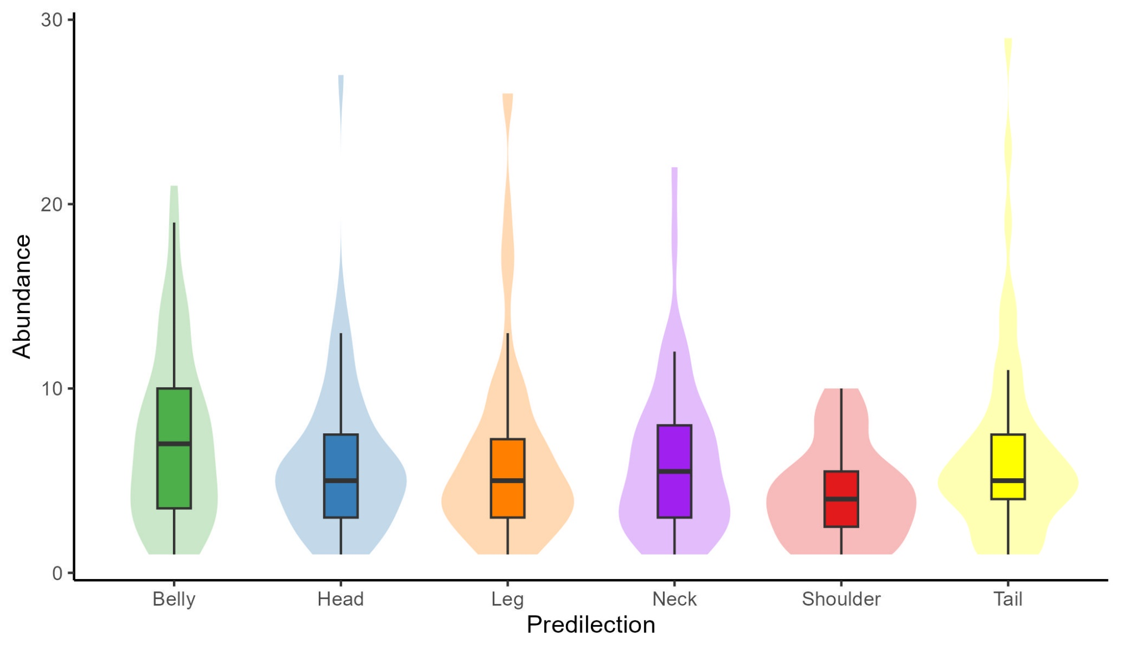
a ab ab ab b ab

Slide 2
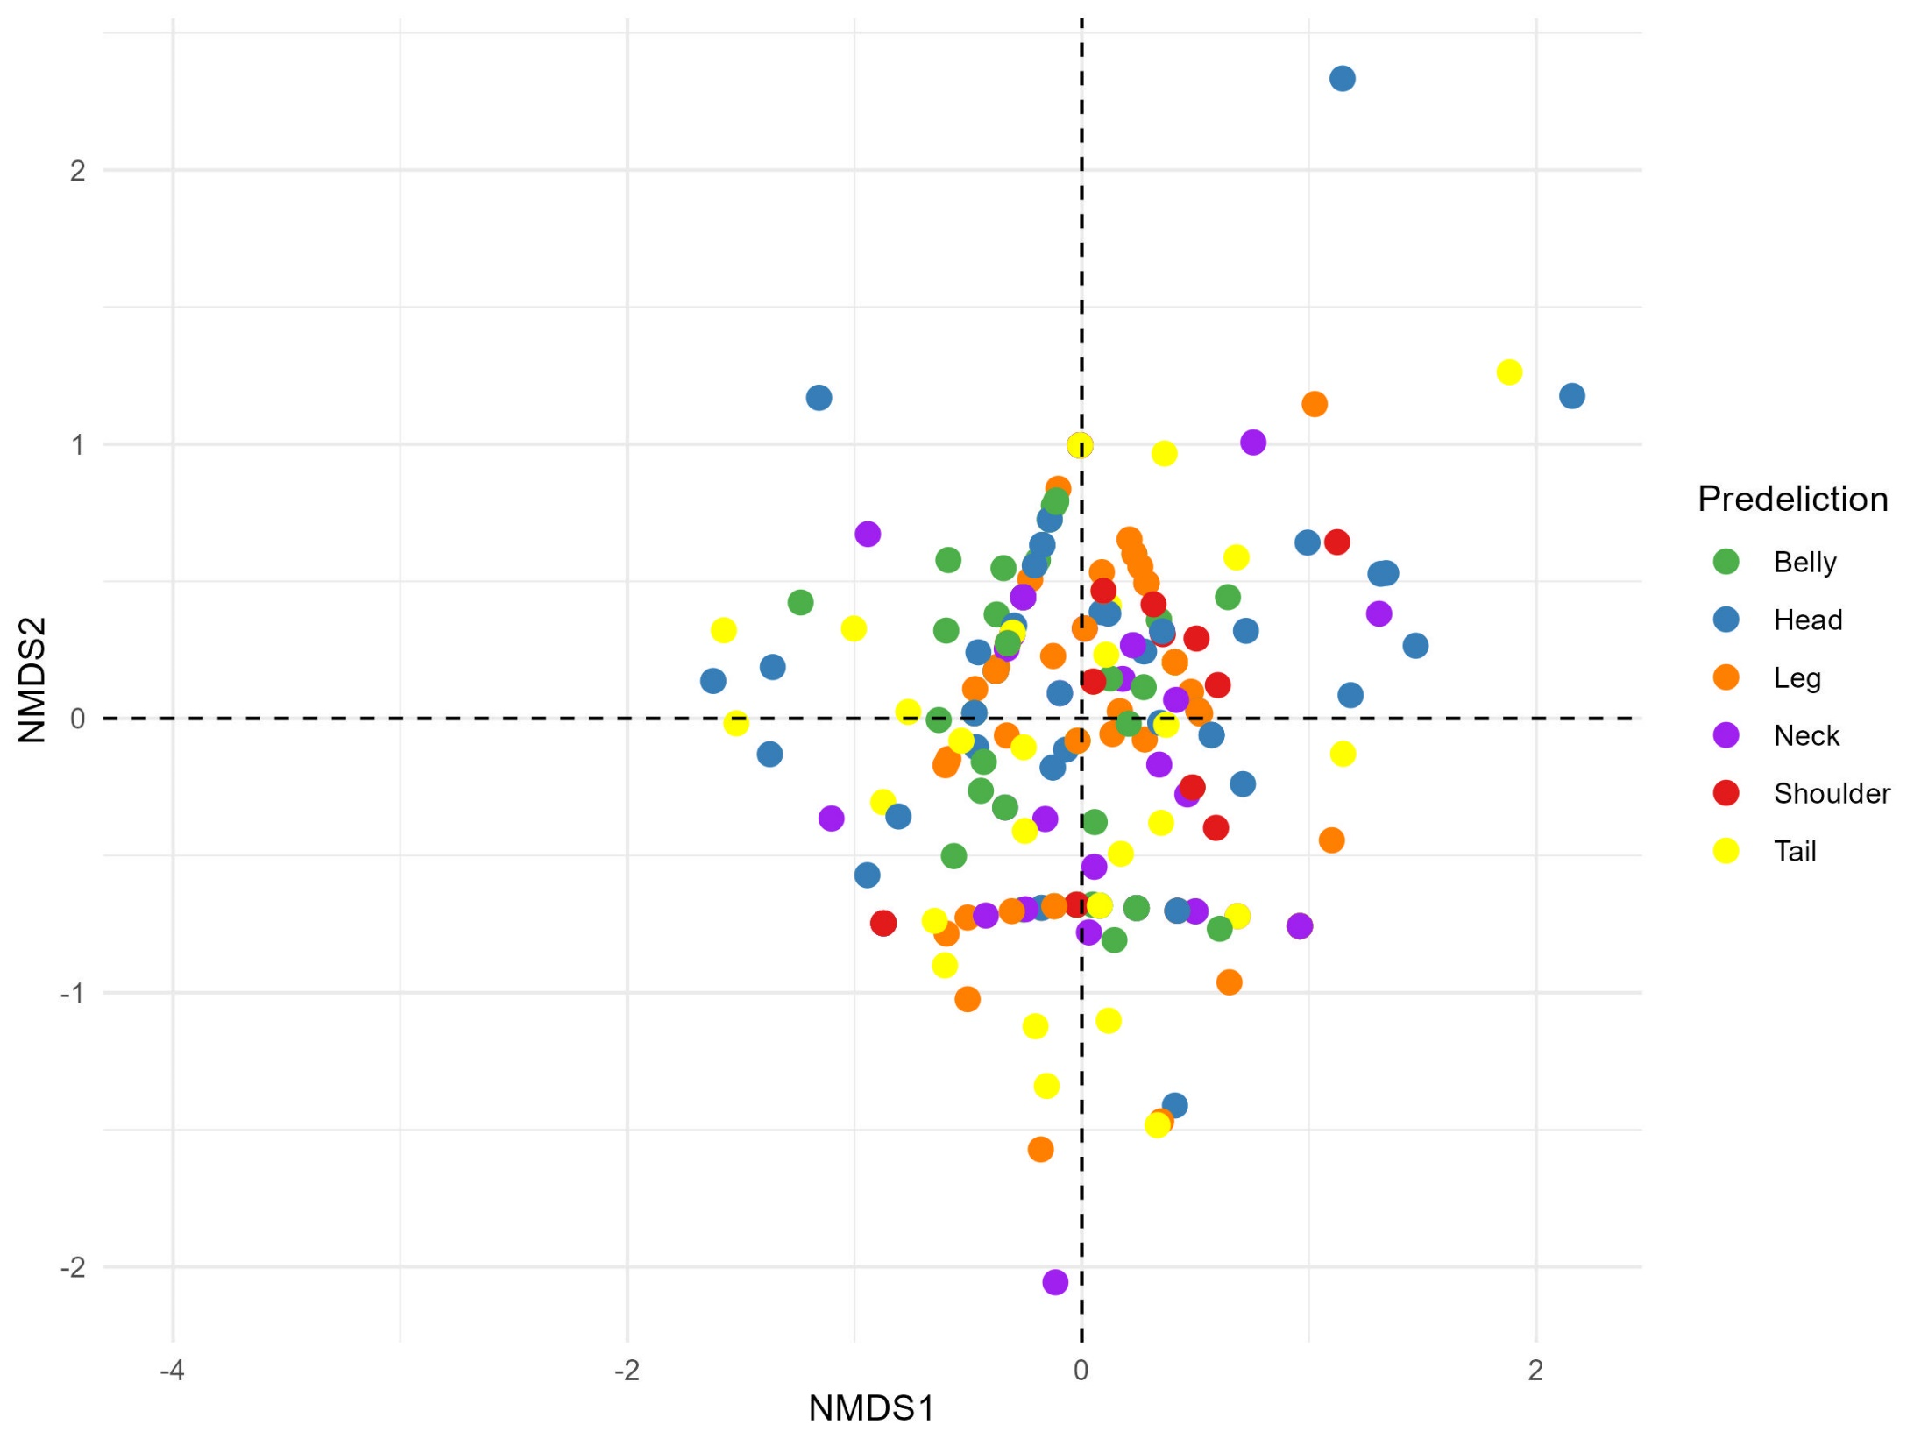
Stress = 0.1399

Slide 3
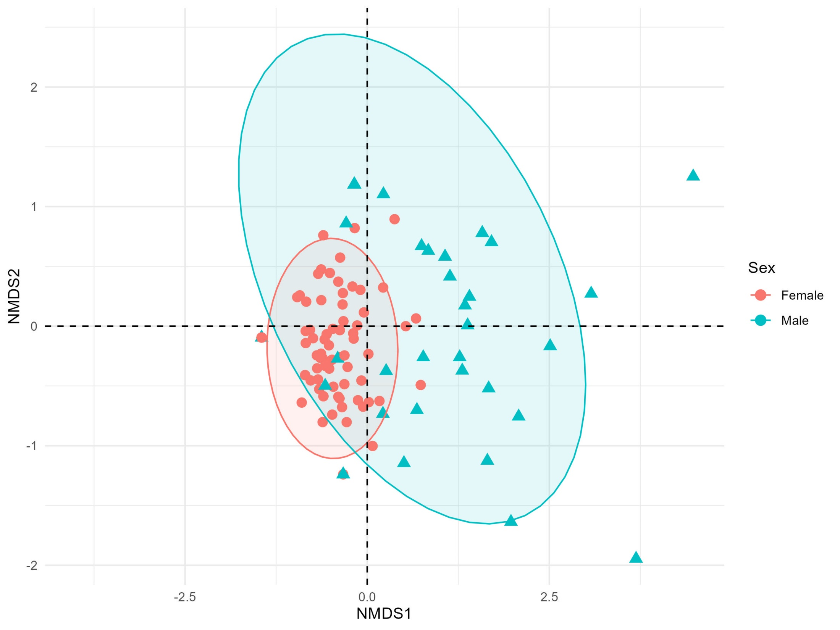
Stress = 0.1297

Slide 4
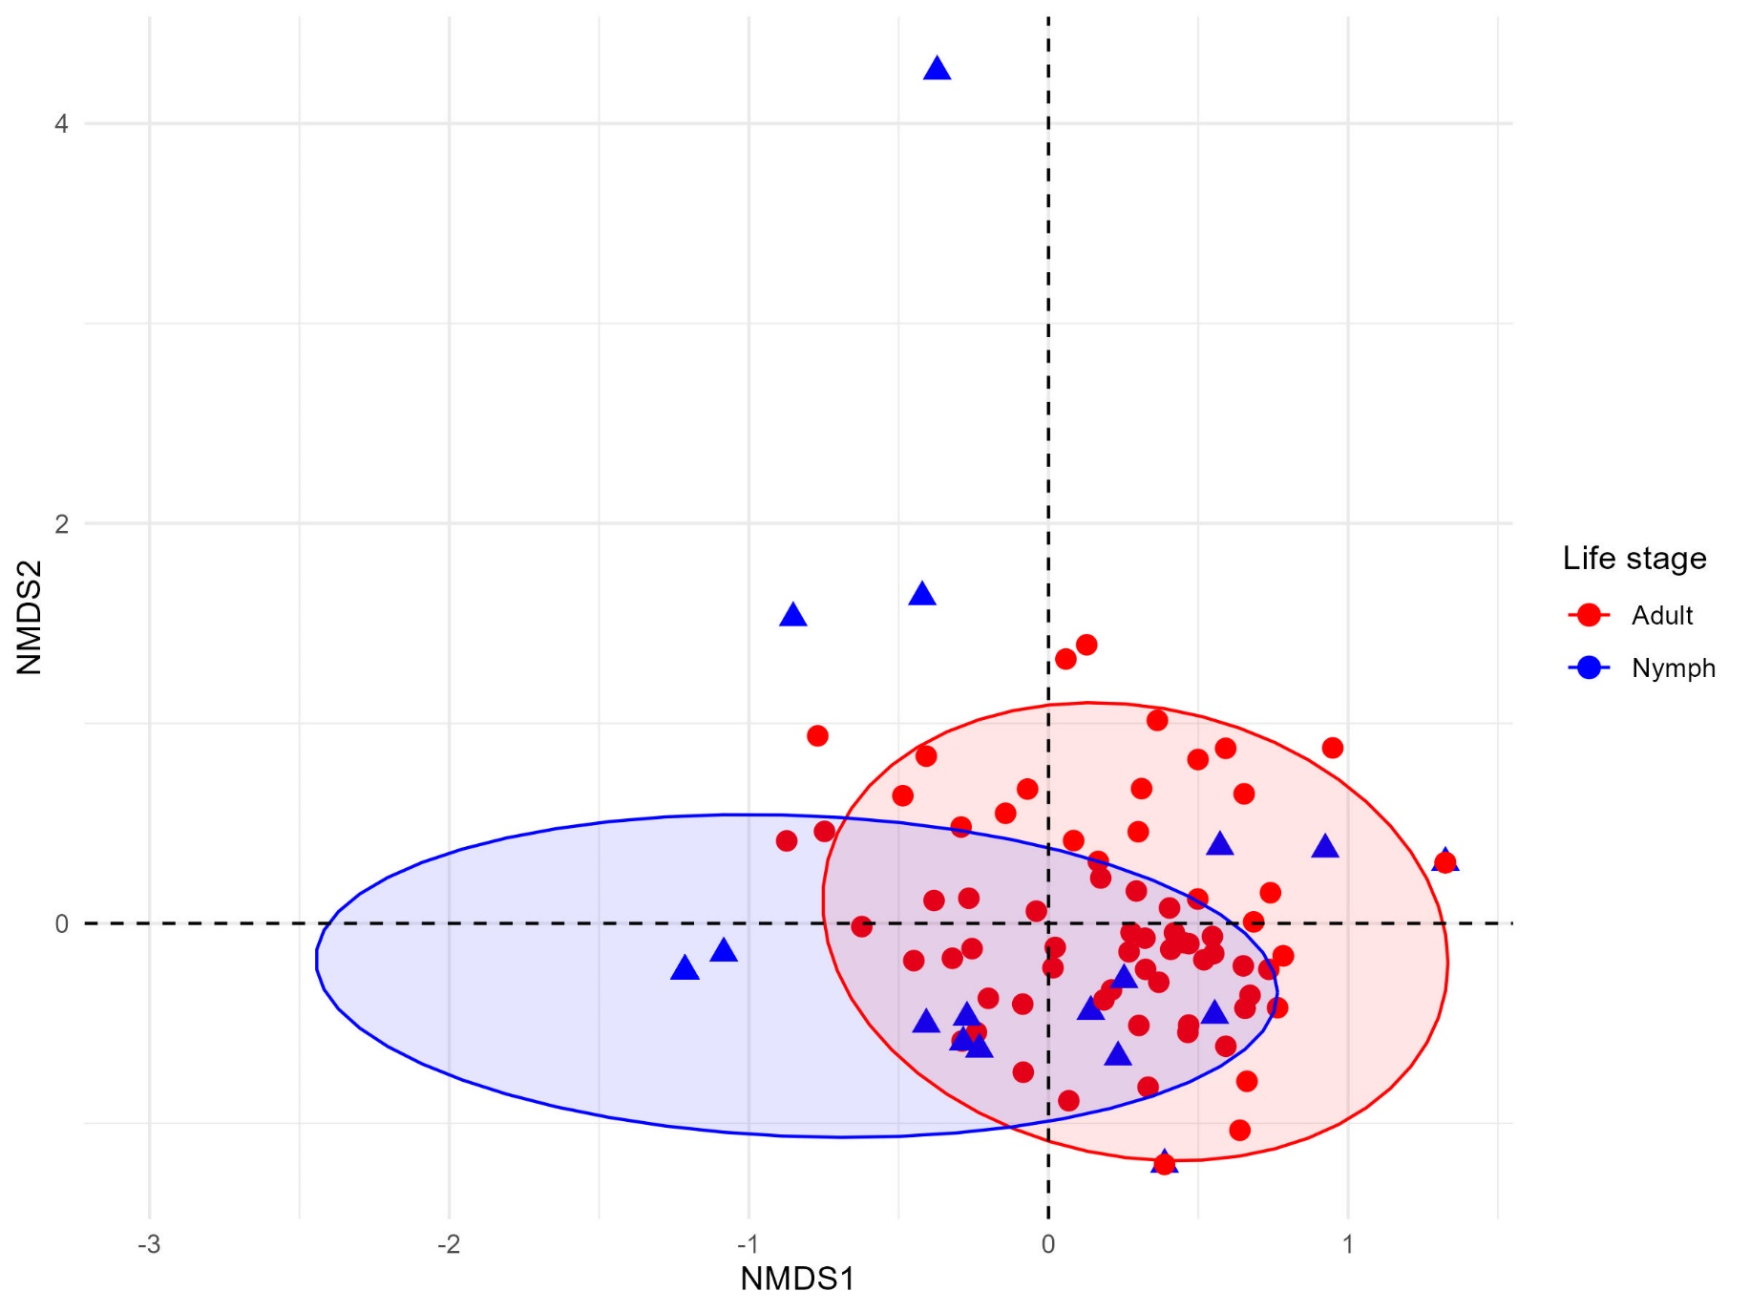
Stress = 0.1646

